Slide 1
Programming Basics

Slide 2
Setting up Environment
● 3 types of software:
● python: the programming language
● a text editor (gvim, emacs, etc.)
● git: A version control system

Slide 3
Main data types used
● Strings: “hello”, “goodbye”
● Integers: -1, 0, 1, 3
● Floats: -4.2, 0.0, 3.14

Slide 4
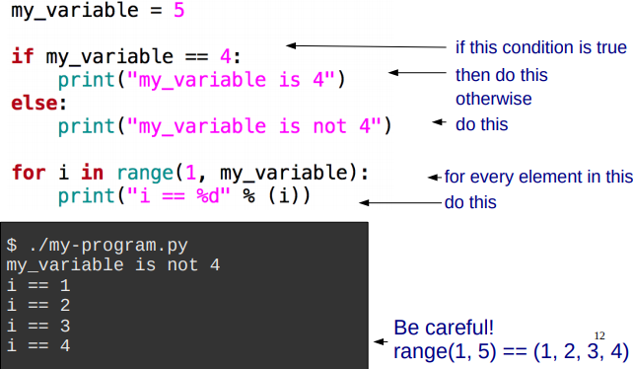
if/else, for

Slide 5
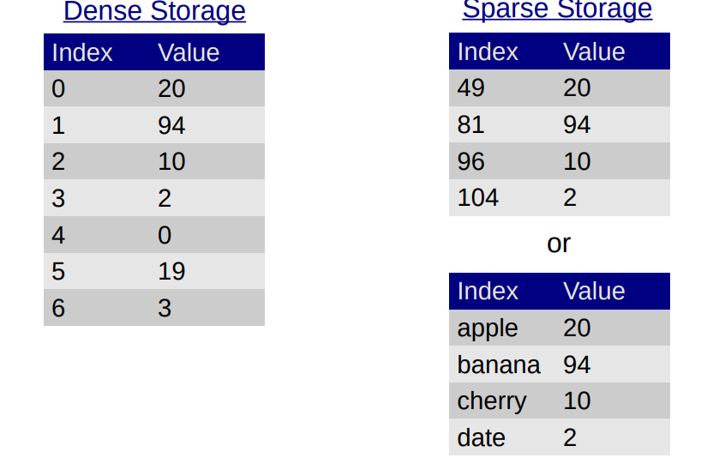
Storing many pieces of data

Slide 6
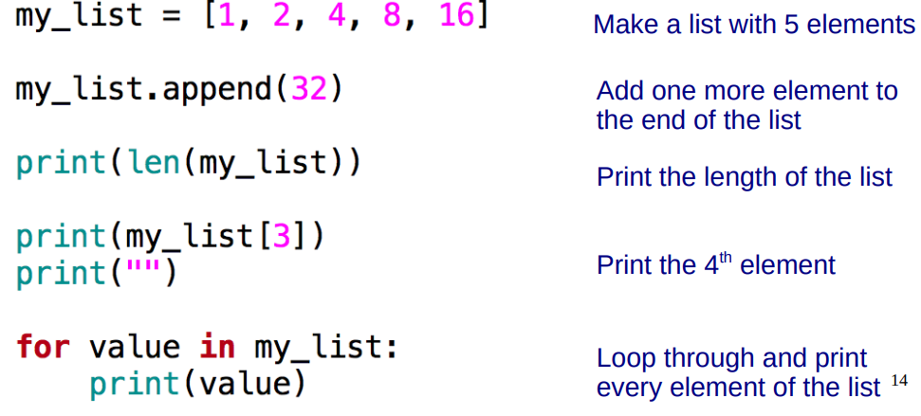
Arrays (or “lists” in Python)
● Good for dense storage
● Index is an integer, starting at 0

Slide 7
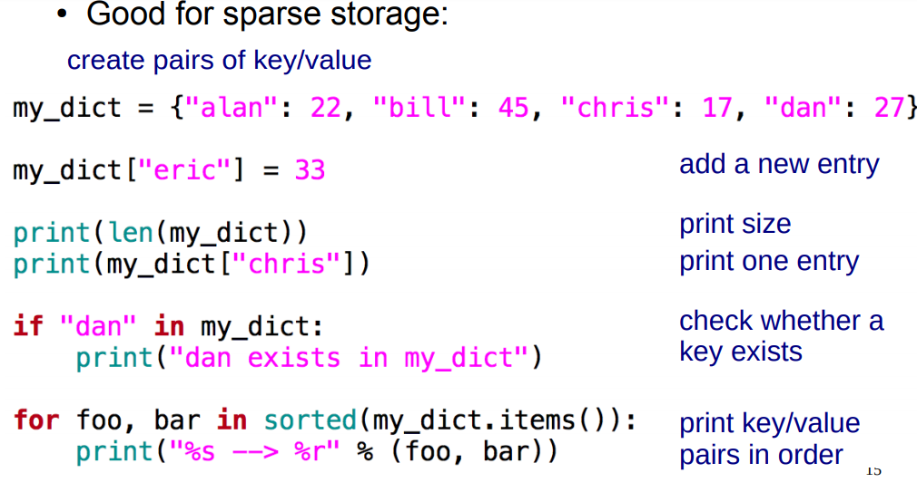
Maps (or “dictionaries” in Python)

Slide 8
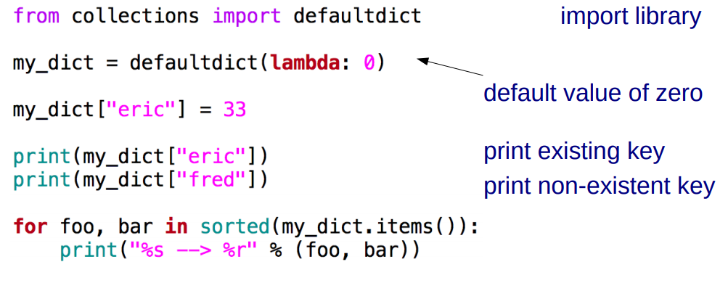
defaultdict
● A useful expansion on dictionary with a default value

Slide 9
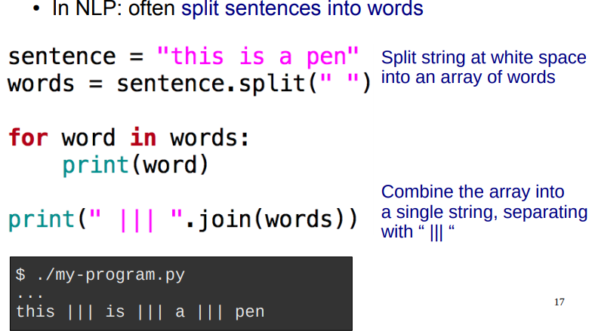
Splitting and joining strings

Slide 10
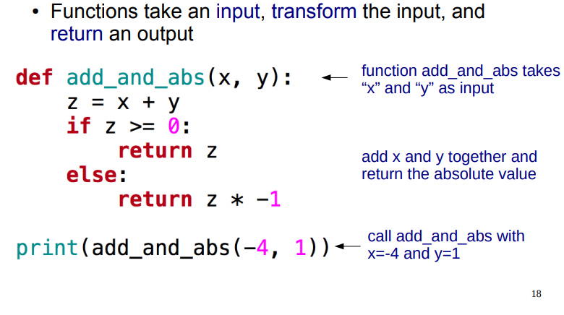
Functions

Slide 11
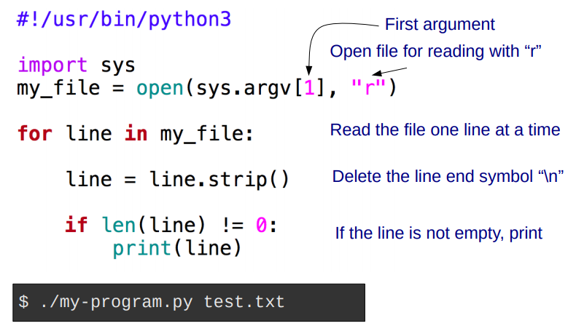
Using command line arguments/ Reading files

Slide 12
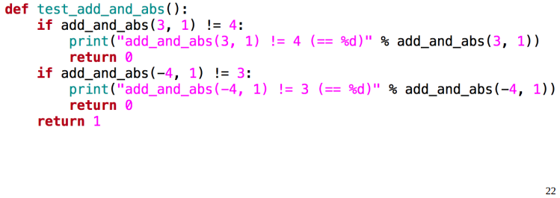
Unit Tests
● Write code to test each function
● Test several cases, and print an error if result is wrong
● Return 1 if all tests passed, 0 otherwise

Slide 13
ALWAYS Test your Code
● Creating tests:
● Makes you think about the problem before writing code
● Will reduce your debugging time drastically
● Will make your code easier to understand later

Slide 14
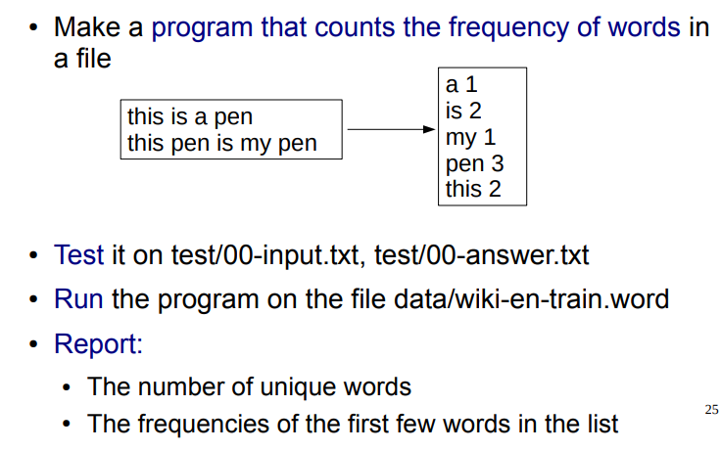
Practice Exercise

